Slide 1
Predicting Arrests in Terry Traffic Stops
DAVID MWAI GATHIMBA

Slide 2
A Data-Driven Approach to Understanding Factors Influencing Arrests

Slide 3
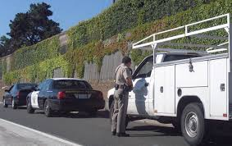
Overview
Understanding the real-world problem: Arrests after Terry Traffic Stops.
Objective: Develop predictive models to determine the likelihood of an arrest based on various factors.

Slide 4
Business Problem
Identifying and understanding the key factors that lead to arrests during Terry Traffic Stops.
Develop a predictive model to accurately forecast the likelihood of an arrest, based on historical data and various demographic and situational factors.

Slide 5

Data
The data is available from Seattle Open Data, the City’s Open Data Portal.
Terry Traffic Stops
Data from 1967 to date.
There are slightly higher than 60,000 records.

Slide 6
Importance of the Problem
01
Fairness in Policing
02
Resource Optimization
03
Policy Formulation

Slide 7



Project Goals
Build a predictive model with high accuracy to determine the likelihood of an arrest during a traffic stop.
Identify key factors influencing arrests to provide actionable insights.
Use findings to recommend data-driven policy changes and operational improvements.

Slide 8
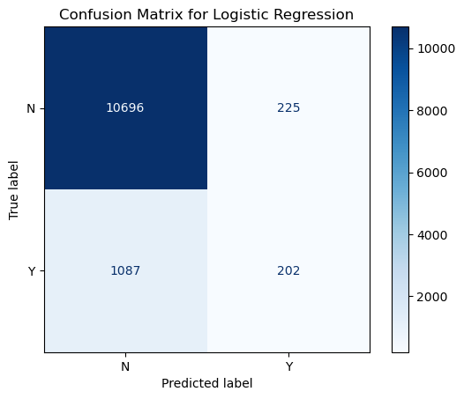
FINDINGS
Confusion Matrix
Linear Regression
True Negative (TN): 10,696
Model correctly predicted "No" (N).
False Positive (FP): 225
Model incorrectly predicted "Yes" (Y) when the actual was "No" (N).
False Negative (FN): 1,087
Model incorrectly predicted "No" (N) when the actual was "Yes" (Y).
True Positive (TP): 202
Model correctly predicted "Yes" (Y).

Slide 9
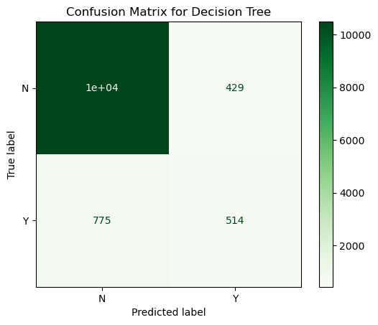
FINDINGS
Confusion Matrix
Decision Tree Model
True Negative (TN): 10,000
Correctly predicted "No" (N).
False Positive (FP): 429
Incorrectly predicted "Yes" (Y) when the actual class was "No" (N).
False Negative (FN): 775
Incorrectly predicted "No" (N) when the actual class was "Yes" (Y).
True Positive (TP): 514
Correctly predicted "Yes" (Y).

Slide 10
RECOMMENDATIONS
Consider incorporating more features that could influence the outcomes of Terry Stops

Slide 11
RECOMMENDATIONS
Training on High Impact Factors
Resource Allocation
Continuous Monitoring
Provide additional training focused on interpreting and responding to factors that have the most significant impact on stop outcomes.
Use the insights from confusion matrices to allocate resources more effectively. For instance, areas or times with high false positive rates may require different policing strategies compared to those with high false negative rates.
Establish a continuous monitoring system to track stop outcomes against predictions.
Real-Time Alerts
Optimize Officer Deployment
Adjust Stop Policies
Develop a system to provide real-time feedback to officers based on predictive analytics models. For example, if a stop has a high probability of being unjustified based on past data, the system can alert the officer to reassess the situation.
Assign officers to areas based on model insights where their presence is most likely to prevent crime without leading to unjustified stops.
Use the findings to refine policies on what constitutes a reasonable stop.

Slide 12
THANK YOU
A Data-Driven Approach to Understanding Factors Influencing Arrests

